Slide 1
SMART CITY DASHBOARD
FEE PROJECT
something about a smart city……
Presentation by:
Aryan Sharma 2210990179
Aryan Sonkar 2210990182
Avinandan 2210990199

Slide 2
Index
Objective
Introduction
Methadology , Approach and Techniques
Software Requirements
Flowchart
Result
Source Code (screenshots)
Conclusion
References

Slide 3
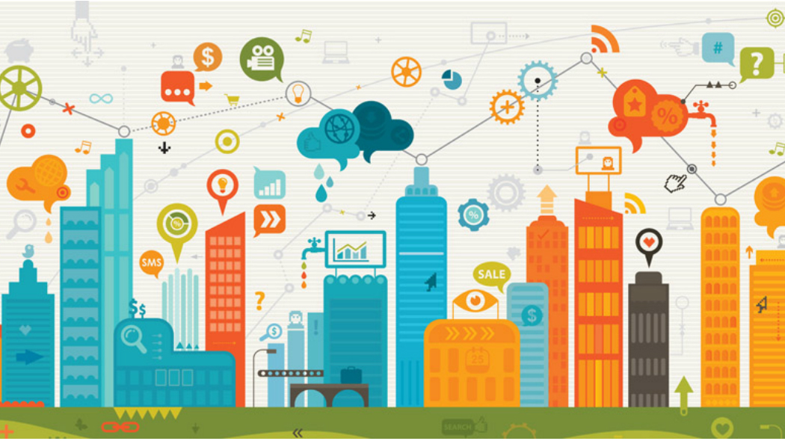
Objective

Slide 4
Objective
Aggregation Data : The primary objective is to aggregate data from various sources within the smart city ecosystem, including traffic management systems,public service databases, and urban development projects.
2. Insight Generation: To provide real-time insights and analytics on key aspects of urban life, air quality, availability of public services, and urban development trends.
3. Visualization: To present the aggregated data in a visually intuitive and userfriendly manner through interactive maps, customizable dashboards.

Slide 5
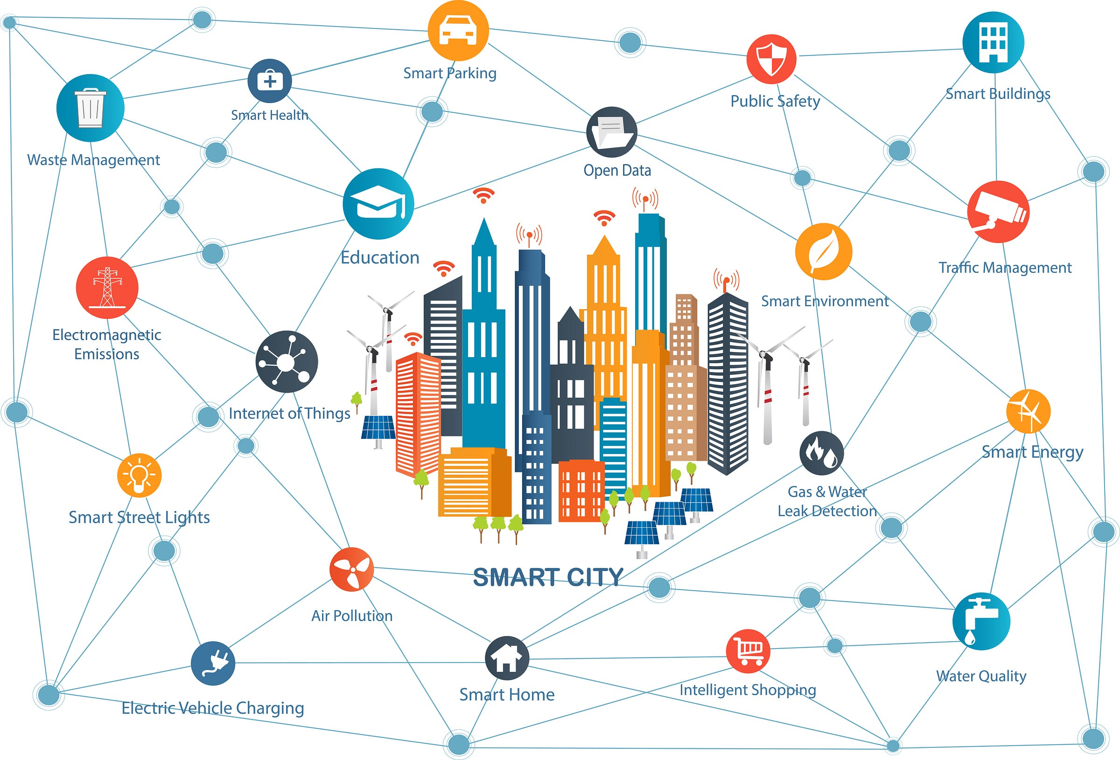
Introduction
In recent years, the rapid pace of urbanization coupled with technological advancements has given rise to the concept of smart cities—urban environments that leverage data and technology to enhance quality of life, sustainability, and efficiency.

Slide 6
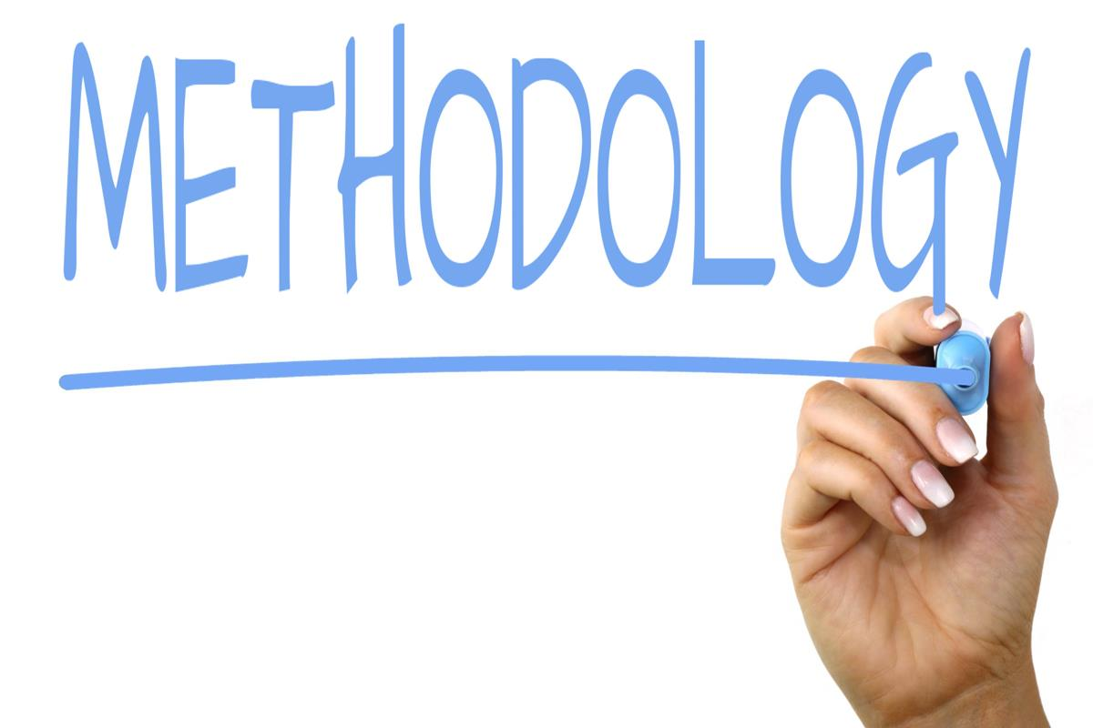
Methadology and Approach
Needs Assessment and Objective Definition
Data Collection
Data Integration and Management
Data Analysis and Processing
Dashboard Design and Development
This Photo by Unknown Author is licensed under CC BY-SA

Slide 7

Techniques
Security and Privacy Techniques
Scalability and Performance Optimization
Standardization
User Interface and User Experience Techniques

Slide 8
Software Requirements
1. Code Editor:
Use a code editor to write and edit HTML, CSS, and JavaScript code. Recommended options include:
-Visual Studio Code
2. Web Browser:
Use a modern web browser for testing and debugging the platform.
Recommended options include: - Google Chrome - Mozilla Firefox - Safari

Slide 9
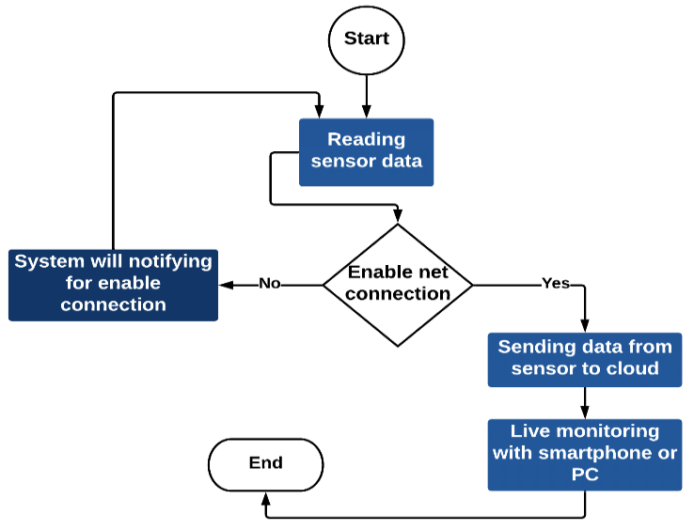
Flowchart

Slide 10
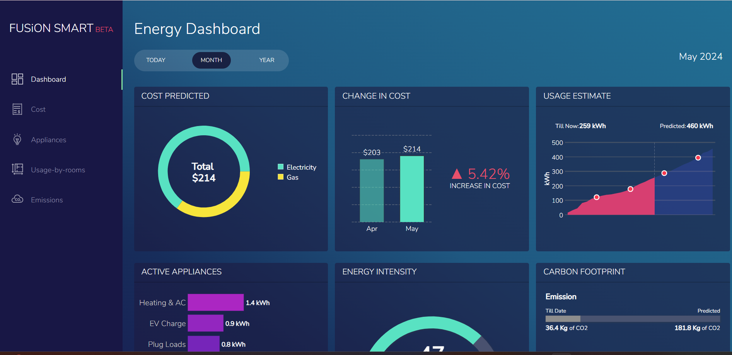
Result

Slide 11
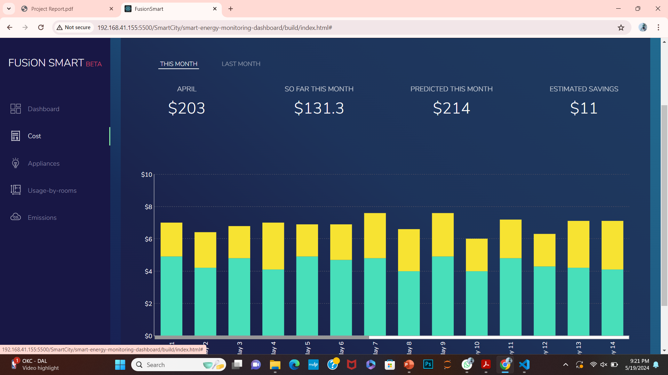
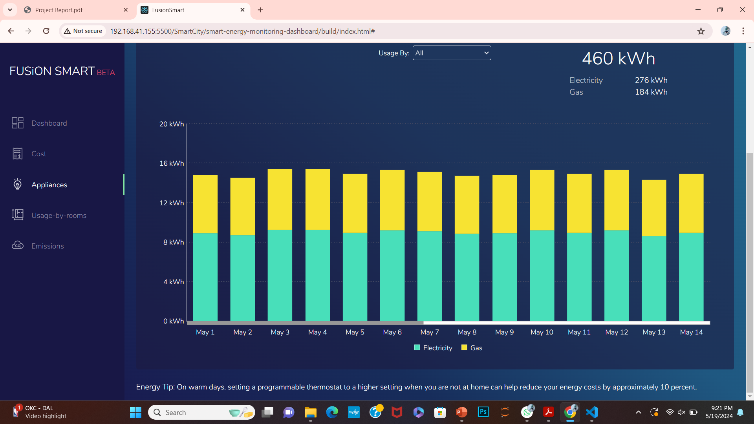
Result-2

Slide 12
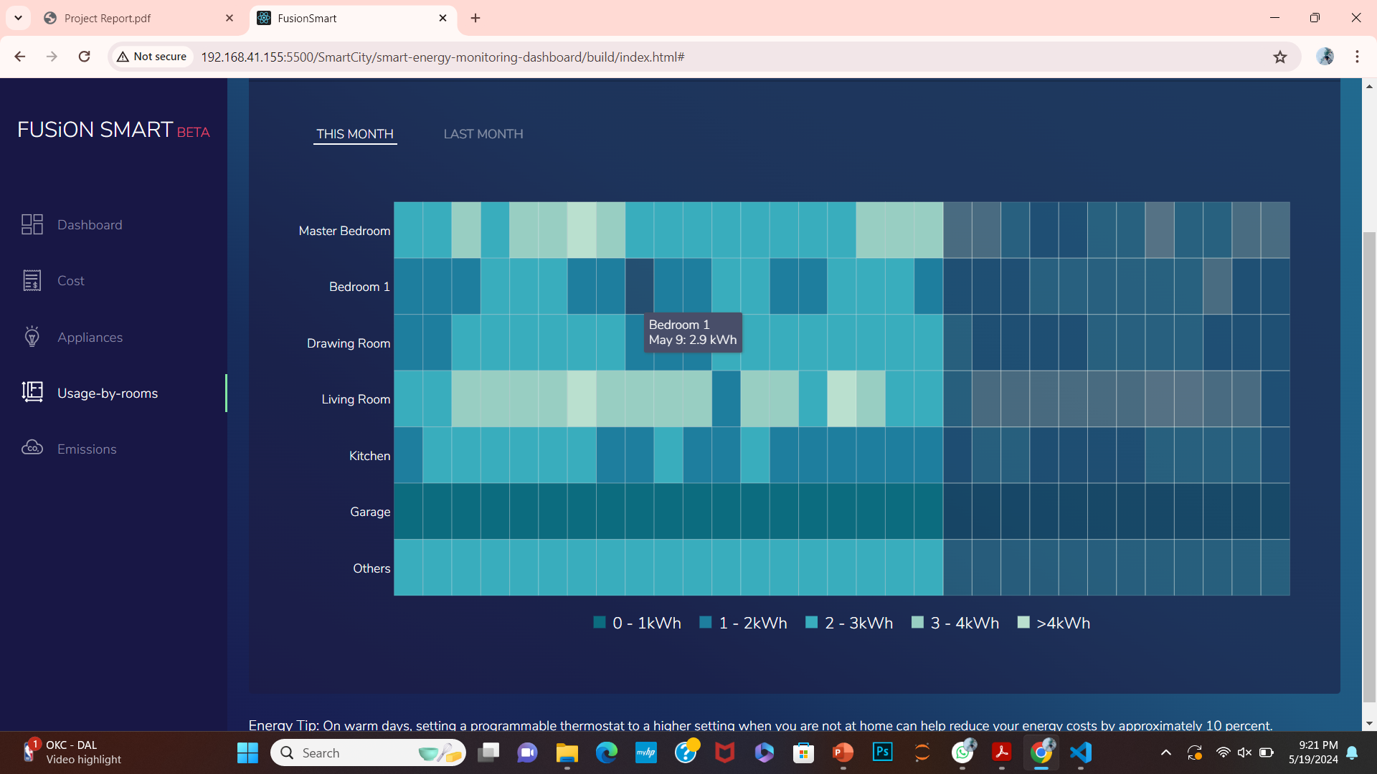
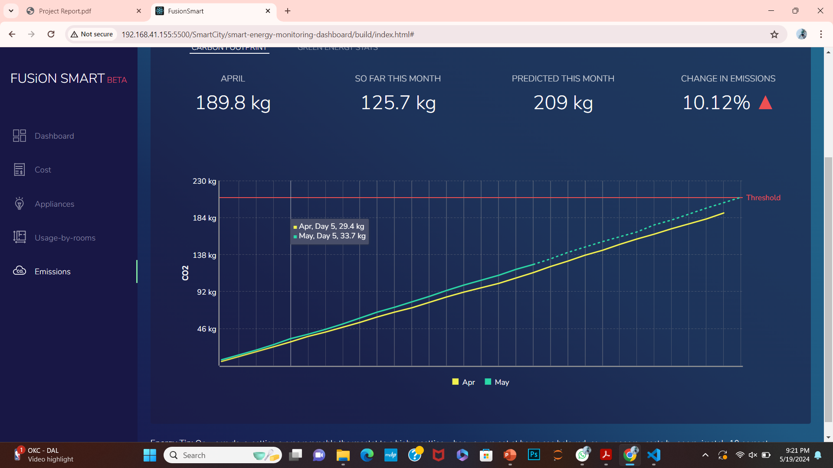
Result-3

Slide 13
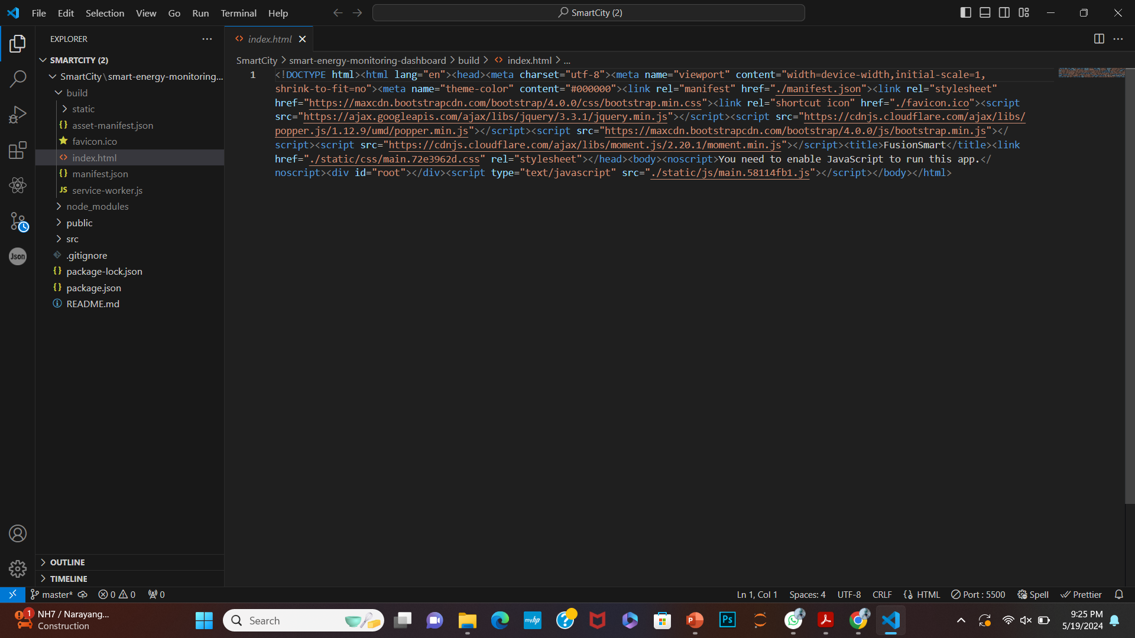
Source Code (screenshots)

Slide 14
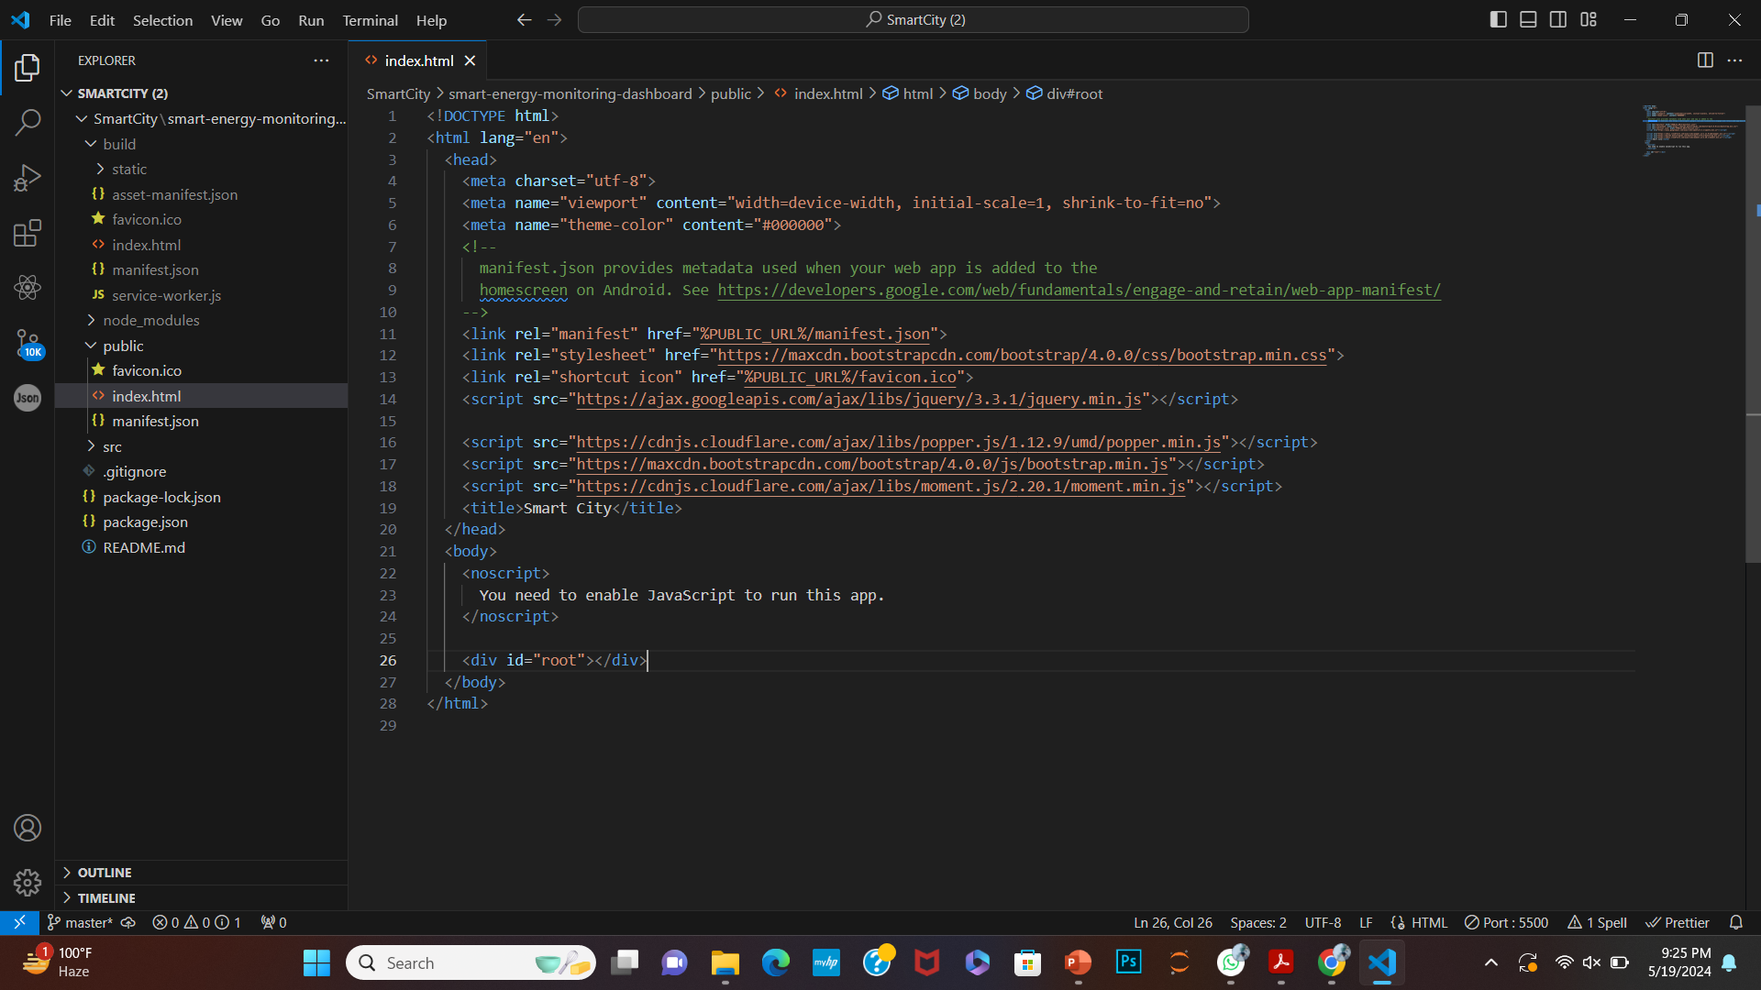
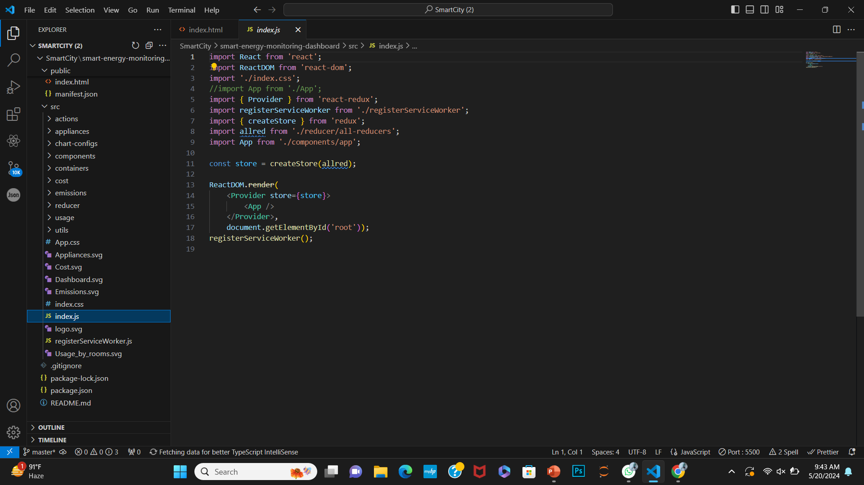
Source code -continued

Slide 15
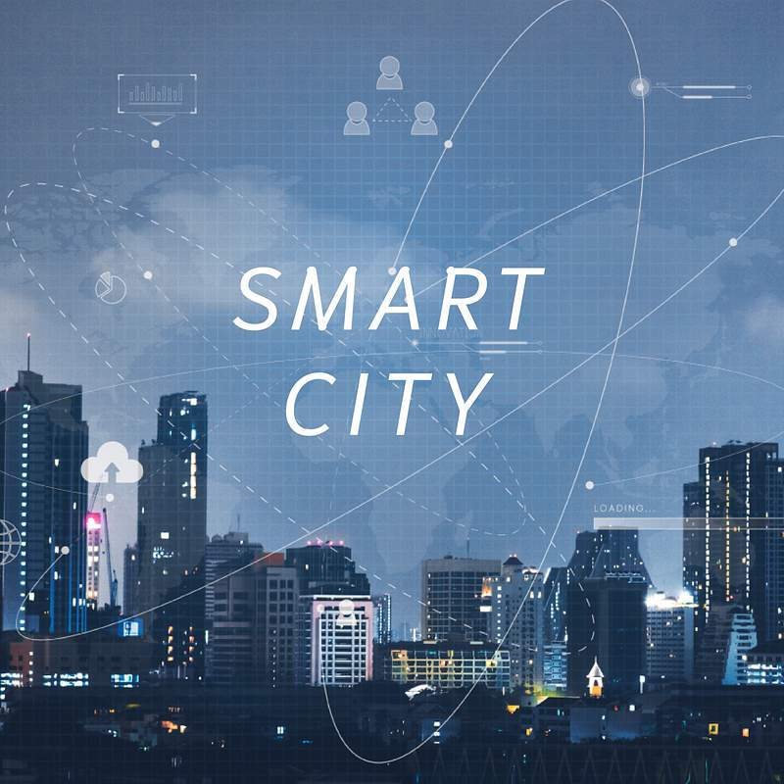
Conclusion
In the era of rapid urbanization and technological advancement, the concept of a Smart City has emerged as a promising solution to address the challenges of modern urban living. Central to the realization of a Smart City is the ability to efficiently collect, analyze, and utilize data from various sources within the city's ecosystem

Slide 16
References
https://chatgpt.com/c/2cdd0d77-7b8d-4c4e-8b53-42c669e35e1e
https://github.com/
https://www.youtube.com/results?search_query=smart+city+dashboard

Slide 17


